Slide 1


Slide 2
NWEA P&R team – 2021 view
Hope
Gabo
NWEA GGP Isabel Yue
Irina Zainea
NWEA P&R
Nordics
UK&I*
France
NL & FI
BeLux
NWEA
Andra Popescu
Nordics
Cristina Popa
Nordics
Livia Ogrezeanu
UK&I
Melania Parvu
UK&I
Gianina Rizea
France
Valentin Cenusa
France
Marcel Gulii
FI & NL
Elena Adams
BeLux
Roberta Galin
NWEA
Alina Enea
Denmark
Daniela Nicolae
Norway
Beatrix Burjan
Sweden’s
Ana Pumnea
Ionela Holban
Andrei Stanciu
Madalina Balaceanu
Cezar Alecu
NWEA Pricing Specialist
TBC
Irina Pavlovschi
Daniel Jidveian
Andy Andrei
Adriana Smarandei
Bogdan Dumitrescu
Ionela Buturache
COMFOM Nordics
TBC
Emiliana Rotaru
Cristina Brasoveanu
SPOC FIN
Cristina Rakosi
COMFOM UK&I
Dragos Stanila
Treasury Nordics
Victor Perciun
SPOC NOR
Cristian Enache
Corp Fin Analyst
Mihail Boscanean
SPOC NL
Vasile Vlad Gaspar
BeLux & France
NWEA Corporate
Finance & HoF
Riklajd Muko
SPOC SWE
Andreea Pruna
Corp Fin NL
* Stage 2

Slide 3
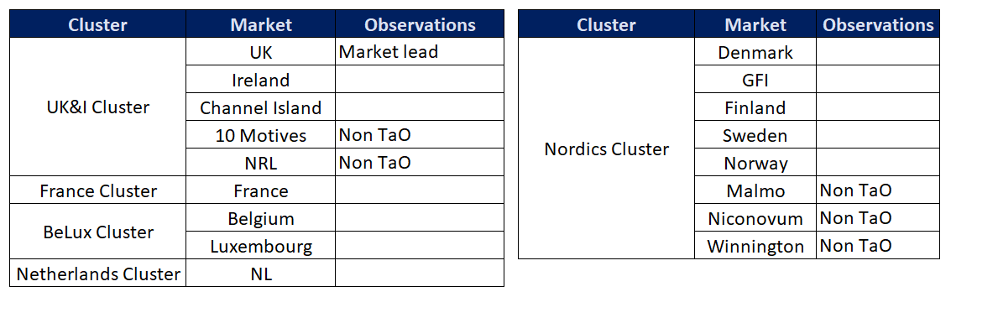
NWEA EMs
Notes:
On a journey …. Aim is to be viewed on the same level
4 buckets
People – we are experts … we have end market roles ….. Regional exposure
Finance – our core ….. Better visibility
Value – enhancements … simplify
Control –support audit …. Priortise Sox
Must and want to go further …. Commercial acumen …. Influence and use our expertise … deliver tangible benefits … allow EM to focus on winning in markets
We are on a journey but are passionate and embracing the change

Slide 4
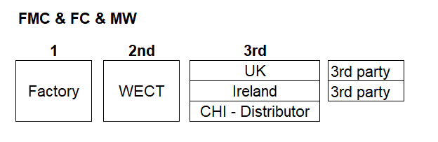
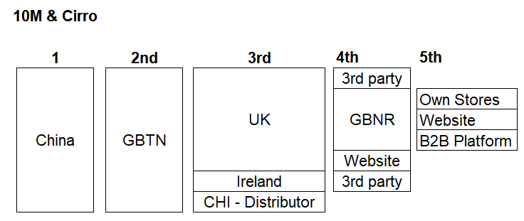
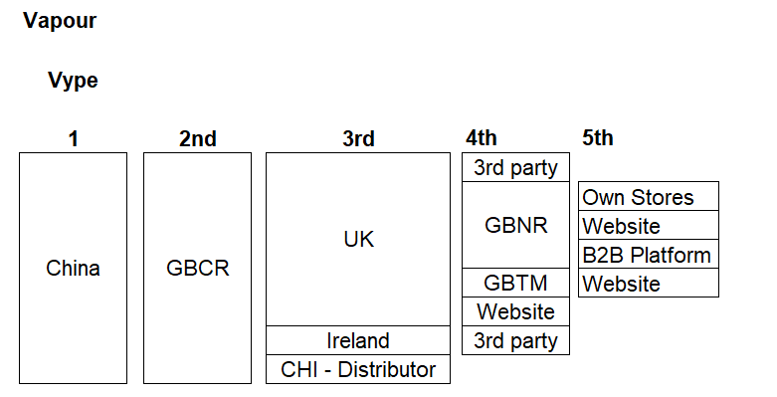
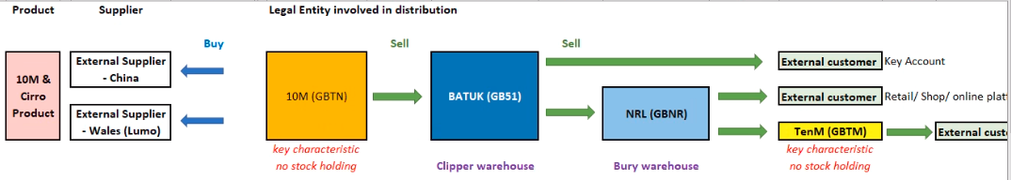

Slide 5
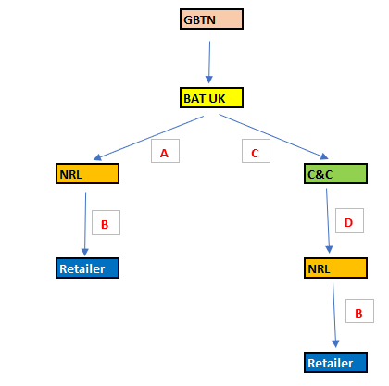

Slide 6






What does this mean for the entity structure/ supply chain for NC
Suppliers
GoVype.com
Consumers
NVT
BAT UK
Key Accounts
10m, Cirro
(internal sales)
Vype, 10m, Cirro
(internal sales)
10M
NRL
Vype Stores & Trade
TENM
10Motives.com
VIP & Vapermarket website sales

Slide 7
UK&I Cluster
UK is market lead in the new area
Biggest contributors to the profit : UK domestic (GB51)
Cross brand business: FMC, FC, Vapour, Modern White
Focus on increasing the Vapour business
UK one of the biggest markets in the group for Vapour (after US)
LRD Model (WECT, GBCR, GBTN)
Traditional retail business, Online websites, Own retail stores (Nicoventures Retail) & Business to Business platform – B2B
Small share in the markets for Traditional Business (12pp), however big GMs per mille to compensate
Pensions applicable in IRE
Notes:
On a journey …. Aim is to be viewed on the same level
4 buckets
People – we are experts … we have end market roles ….. Regional exposure
Finance – our core ….. Better visibility
Value – enhancements … simplify
Control –support audit …. Priortise Sox
Must and want to go further …. Commercial acumen …. Influence and use our expertise … deliver tangible benefits … allow EM to focus on winning in markets
We are on a journey but are passionate and embracing the change

